Slide 1
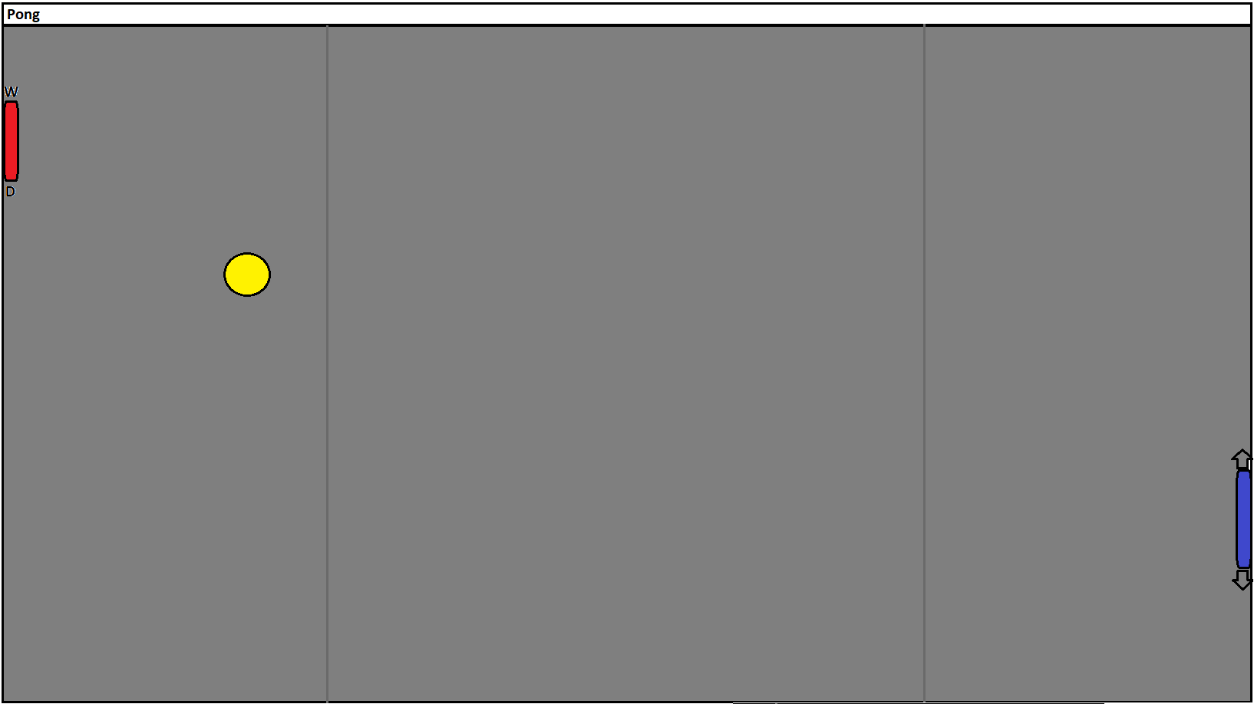

Shapes will drop down and can modify all parameters of game when hit by ball
Variable:
-width
Variable:
-diameter
-velocity
This shape adds another ball to the game

